Slide 1


JAWAHARLAL NEHRU NEW COLLEGE OF ENGINEERING
SHIMOGA DEPARTMENT OF COMPUTER SCIENCE AND ENGINEERING
A Project Seminar
on
“ ANTI-PHISHING: A WEB IDENTIFIER FOR SPOOFED SITES USING NEURAL NETWORKS ”
Presentation by
Akshatha A P 4JN20CS005
Chaithra R 4JN20CS024
Madhura S 4JN20CS050
Chandana C Sagar 4JN20CS127
Under the Guidance of
Mr. Hiriyanna G S B.E , M.Tech
Asst.Professor, Dept of CS&E
PROJECT COORDINATORS
Dr. K. M.Poornima B.E, M.Tech, Ph.D
Professor, JNNCE
Dr. Ganavi M B.E, M.Tech, Ph.D
Asst.Professor, JNNCE
Mr. Hiriyanna G S B.E, M.Tech
Asst.Professor, JNNCE
Mrs. Pushpa R N B.E, M.Tech
Asst.Professor, JNNCE
Date:27.05.2024

Slide 2
CONTENT
Abstract
Introduction
Literature Survey
Motivation
Problem Statement
Objectives
Technologies
System Architecture
Conclusion
References

Slide 3
ABSTRACT
Phishing is a type of cybercrime involving technological and social approaches to collect financial and personal data from users. Phishing attacks persist as a significant threat to cybersecurity, exploiting deceptive websites to illicitly acquire sensitive user information. An approach for detecting phishing websites using Long Short-Term Memory (LSTM) networks, a type of recurrent neural network (RNN) known for its ability to capture sequential dependencies in data. The project involves implementing a feature-based extraction approach for URLs. By extracting relevant features and passing it to deep learning LSTM and dense training model to recognize both legitimate and phishing website.

Slide 4
INTRODUCTION
Nowadays, we are witnessing an increase in the number of vulnerabilities and threats from web-based cyberattacks. Over the years, cybercriminals have been using techniques that are becoming more sophisticated and organized to steal people's private information and their credentials. Phishing attacks largely occur due to incapability of web browsers/users to distinguish between legitimate and a phishing website. But the classification can made very effectively with the help of deep learning concepts and algorithm.

Slide 5


Slide 6
1. Deep Character-Level Anomaly Detection Based on a Convolutional Autoencoder for
Zero-Day Phishing URL Detection[3].
Authors: Seok-jun bu , Sung-bae cho.(2021)
METHODOLOGY | CONTRIBUTIONS | ADVANTAGES | LIMITATIONS
Combination of a convolution operation to model character-level URL features and a deep convolutional autoencoder (CAE) to consider nature of zero-day attacks. URL preprocessing A Character-level deep URL model based on an autoencoder. Phishing URL detection based on the abnormal score. | This paper formulated anomaly detection problem with deep auto encoder and this is the first attempt where a convolutional autoencoder is incorporated to reconstruct a URL and measure the abnormal score for a phishing attack. | Innovation in Anomaly Detection. Disentanglement between Classes. | It was optimized for character-level features among the various features constituting URLs. The confusion of character-level features is identified as the main cause of performance degradation for the proposed method.

Slide 7
2. A Deep Learning-Based Framework for Phishing Website Detection[4].
Authors: Lizhen Tang, Qusay H. Mahmoud.(2021)
METHODOLOGY | CONTRIBUTIONS | ADVANTAGES | LIMITATIONS
In this paper, a deep learning-based framework is used to detect phishing links in a real-time web browsing environment. Collection, analysis and storing of data. Configure and classification of data. Web browser extension. | The proposed approach has a prototype implementation of the proposed framework as a chrome browser extension and achieved the highest accuracy with the RNN-GRU model. | Real time browsing environment. Running in real time without delays. Experimental data can be tracked. | Short links cannot be detected. Limited number of character is trained results in information loss.

Slide 8
3. Phishing Website Detection Based on Deep Convolutional Neural Network and Random Forest Ensemble Learning [5].
Authors: Rundong Yang, Kangfeng Zheng, Bin Wu, Chunhua Wu and Xiujuan Wang.(2021)
METHODOLOGY | CONTRIBUTIONS | ADVANTAGES | LIMITATIONS
This paper proposes an integrated phishing website detection method based on convolutional neural networks (CNN) and random forest (RF). URL Character Embedding. Designing an improved CNN network. Ensemble classification. | Phishing website detection technique based on integrated learning and deep learning. It uses URL features. A real data set is built and experimented extensively. | Strong generalization ability. Third-party service independence Independence of cybersecurity experts. Language-independent. | It takes longer to train. The model cannot determine whether the URL is active or not.

Slide 9
4. A Deep Learning-Based Phishing Detection System Using CNN, LSTM, and LSTM-CNN[9].
Authors : Zainab Alshingiti ,Rabeah Alaqel ,Jalal Al-Muhtadi and Muhammad Hamza Faheem. (2023)
METHODOLOGY | CONTRIBUTIONS | ADVANTAGES | LIMITATIONS
Three different techniques are compared to check the robustness of the system. Data collection and feature identification. Data preprocessing using SelectKBest Method. Training using CNN,LSTM, LSTM-CNN. Output data classification. | In this paper, three different methodology is specified along with this, comparison between these methodologies is made and among them CNN proved to show best result. Dataset consideration with 30 features after feature extraction. | Human expertise is not required. Large data sets can be processed. Comparison of three different methodology. Light weight CNN model is used. | The significant increase in computation time. The model does not check the status of the URL of the website.

Slide 10
An enhanced deep learning‐based phishing detection mechanism to effectively identify malicious URLs using variational autoencoders[12].
Authors : Manoj Kumar Prabakaran, Abhinaya Devi Chandrasekar, Parvathy Meenakshi Sundaram.(2023)
METHODOLOGY | CONTRIBUTIONS | ADVANTAGES | LIMITATIONS
This paper proposes a method which effectively classifies URL based on hybrid DN model named VAE-DNN. URL preprocessing. URL feature Extraction using VAE model. DNN model for detecting malicious websites. | This paper eradicates the complexity involved in manual feature engineering. It also reduces reliance on third party services to extract certain features and adopted the variational autoencoder (VAE) model for the process of feature extraction. | Avoiding of overfitting and non‐regularisation Automatically extract higher‐level features. Do not require third party services. | Information loss. Longer duration for training.

Slide 11
MOTIVATION
Phishing is a type of methodologies which are used to acquire the information. Phishing is mainly a form of online Identify theft.
Users who cannot identify the phishing websites can give their personal information like their identification details, credit card details , password which can lead to financial theft.
There can be misuse of user information like his personal identity can be misused intentionally and the user can fall into the trouble.
To overcome this, we can build a model which identifies malicious websites and notify the user so that financial identification theft through these websites can be mitigated.
Neural networks are used because they rely on training data to learn and improve their accuracy over time.

Slide 12
PROBLEM STATEMENT
In recent years, Internet technologies are grown pervasively not only in information-based web pages but also in online social networking and online banking, which made people’s lives easier. As a result of this growth, computer networks encounter with lots of different security threats from all over the world. Malicious URLs are a common threat to the Web users. Phishing aims at stealing sensitive information by providing falsified interfaces. In the case of phishing websites, attackers usually try to impersonate well-known and widely used services such as social media, banks and e-commerce websites. Such spoofed websites are often built from the same code base as the original site, which could make them difficult to detect at first glance. Thankfully, numerous other indicators can be used to differentiate benign and phishing websites. For instance, most phishing URLs tend to be very long, with multiple sub-domains and special characters.

Slide 13
OBJECTIVES
The objective of this project is to train deep neural network on the dataset created to predict phishing websites.
To recognize the legitimate websites and phished websites through URL.
Deep learning training model that recognizes both the legitimate and phishing websites.
Implementing the model to directly recognise the phishing website in the browser

Slide 14
TOOLS USED
Python: Python is commonly used for deep learning projects due to its rich libraries and ease of use.
Deep Learning Frameworks: Numpy, Pandas, Beautiful soup, Regex are a popular choices for deep learning tasks. These frameworks provide tools for building and training neural networks.
Selenium WebDriver: Selenium is used for automating web browser interaction. With a Selenium plugin, you can control web browsers programmatically, which is useful for scraping and interacting with web content.

Slide 15
URL Dataset : Dataset called phishing.csv file consisting of 11056 data, which is based on features of URL. These datasets are used for training and testing the deep learning models.
Jupyter Notebook: Jupyter Notebook allows for interactive data analysis, where you can explore and visualize the dataset using Python libraries.
Xampp: XAMPP is a software package that includes Apache, MySQL, PHP, and Perl. It's used for local development and testing of web applications.
Environment Setup:
Web Browser: Google Chrome for web interactions.
Chrome WebDriver: Interacting with the Chrome browser through Selenium

Slide 16
TECHNOLOGIES
1. DEEP LEARNING:
Deep learning can be defined as the method of machine learning and artificial intelligence that is intended to intimidate humans and their actions based on certain human brain functions to make effective decisions.
Supervised Learning
Unsupervised Learning
ALGORITHMS:
LSTM (Long Short Term Memory Model ):
LSTM is well-suited for sequence prediction tasks and excels in capturing long-term dependencies.
LSTMs Long Short-Term Memory is a type of RNNs Recurrent Neural Network that can detain long-term dependencies in sequential data.

Slide 17
Advantages of LSTM (Long Short Term Memory Model ):
It can be captured by LSTM networks and capable of long-term information storage.
It is able to train model over a long sequences and there will be no problem of vanishing and exploding.
It enables to capture and remember the important context.
2. Dense Layer:
A dense layer, also known as a fully connected layer, where ever neuron is connected to every neuron in the previous layer. This layer takes output from LSTM cells and processes it, and transforms into desired output format.
Types:
Single Layer perceptron
Multi-layer perceptron

Slide 18
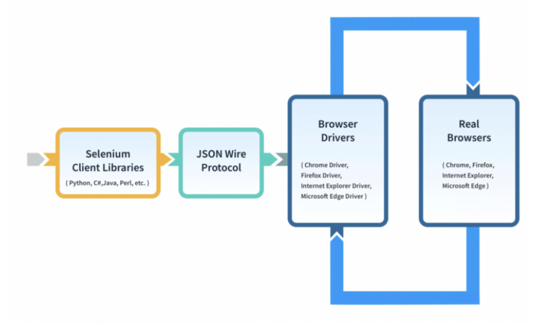
2. Selenium
Selenium Web Driver is a popular open-source library and a key component of the Selenium automation framework.
Fig.2 Selenium architecture

Slide 19
Selenium WebDriver Architecture is made up of four major components:
Selenium Client library
JSON wire protocol over HTTP
Browser Drivers
Browsers
Advantages:
Open-source, free-to-use, portable tool.
Combination of several Domain Specific Language (DSL) and other tools which allow you to perform various types of testing.
It is quite easy to understand, intuitive, and has a low learning curve.
It takes off a load of the burden from testers.
There is a significant reduction in the costs incurred to the business clients, which is a win-win situation.

Slide 20
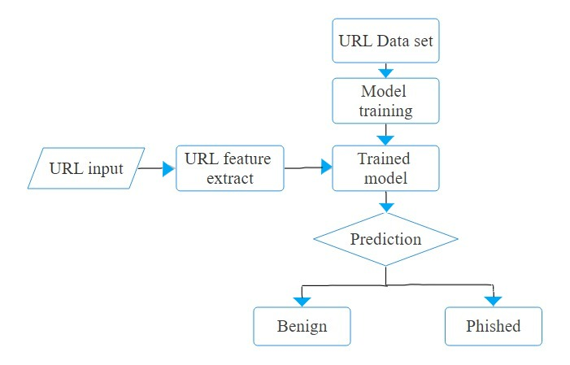
SYSTEM ARCHITECTURE
Fig.4: System Framework

Slide 21
METHODOLOGY
Feature Extraction
Basically, there are 4 main features which has in total 30 sub-features. Based on the data, every single feature provides information about whether the website can be benign,phishing or suspicious.
1. Address Based Features:
IP Address
URL Length
Use of URL Shortening Services
Presence of ‘@’ Symbol
Presence of ‘//’
Having ‘-’ in domain name

Slide 22
SSL Certificate Status
Domain expiry date
Favicon Matching
Port Availbility
“HTTPS” or “HTTP” on domain
Abnormal Based Features:
Request URL
Using <a>tags
Links in tag such as <meta><script><links>
Submitting Information to Email
Abnormal URL

Slide 23
HTML and JavaScript based Features:
Website forwarding
Status Bar Customization
Disabling Right Click
IFrame usage
Domain Based Features:
Age of Domain
DNS record
Google Index
Links pointing to Page
Statistical Reports

Slide 24
Model Development:
Data Loading and Preparation:
Initially, the dataset is loaded then examined for any missing values. This step ensures data quality and integrity.
Data Splitting:
The dataset is divided into training and testing sets using the train_test_split function from scikit-learn. This division allows for model evaluation on unseen data.
3. Model Architecture:
Two LSTM layers are stacked one after the other
LSTM Layer 1
LSTM Layer 2
Dense Layer 1
Dense Layer 2

Slide 25
Model Compilation:
The model is compiled using the Adam optimizer and mean squared error loss function.
Model Training:
Training involves iteratively adjusting the model's weights to minimize the loss function.
Model Deployment:
Setup and Model Loading: Configure Selenium for web automation and load pre-trained model for website threat detection.
Real-time Detection and Analysis: Continuously monitor visited URLs, extract relevant features, and predict their threat level using the pre-trained model.
Decision-making and Action: Based on the model's predictions, decide on appropriate actions, such as alerting the user and redirecting to a safety page, if the threat level exceeds a set threshold.

Slide 26
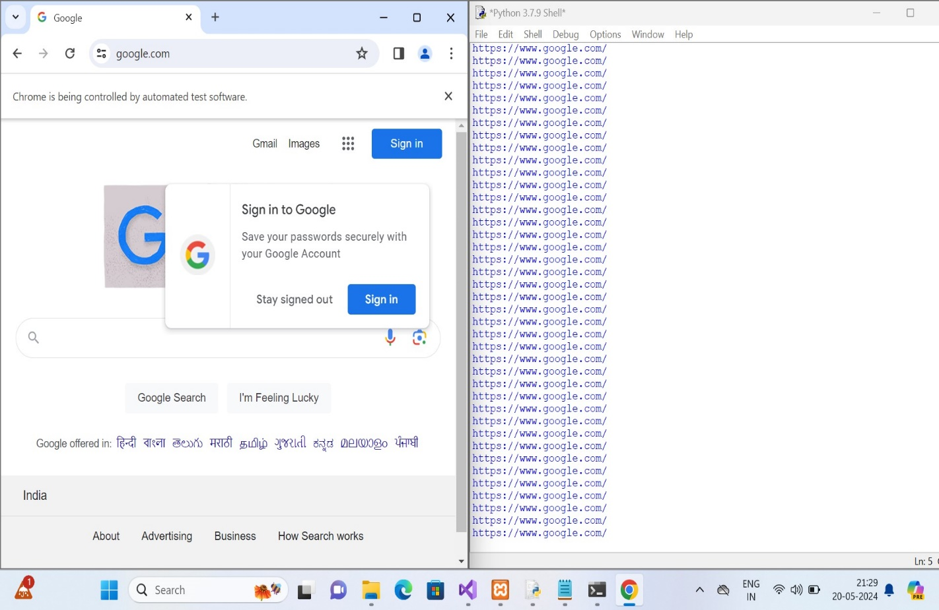
SNAPSHOTS
Fig.5 Default Chrome browser running in frontend and backend.

Slide 27
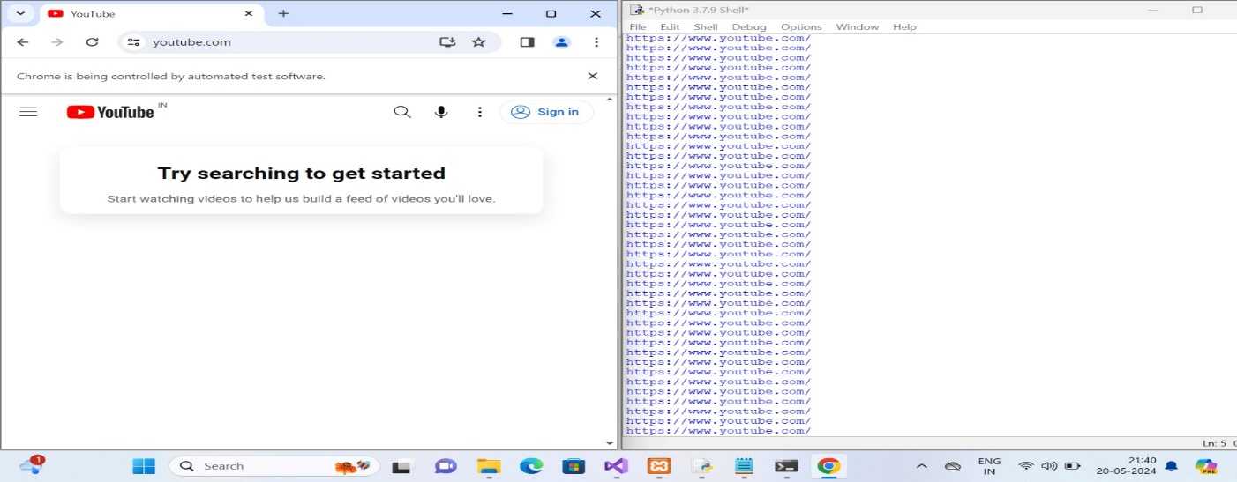
Fig.6 Entered Youtube.com in URL field which is Genuine.

Slide 28
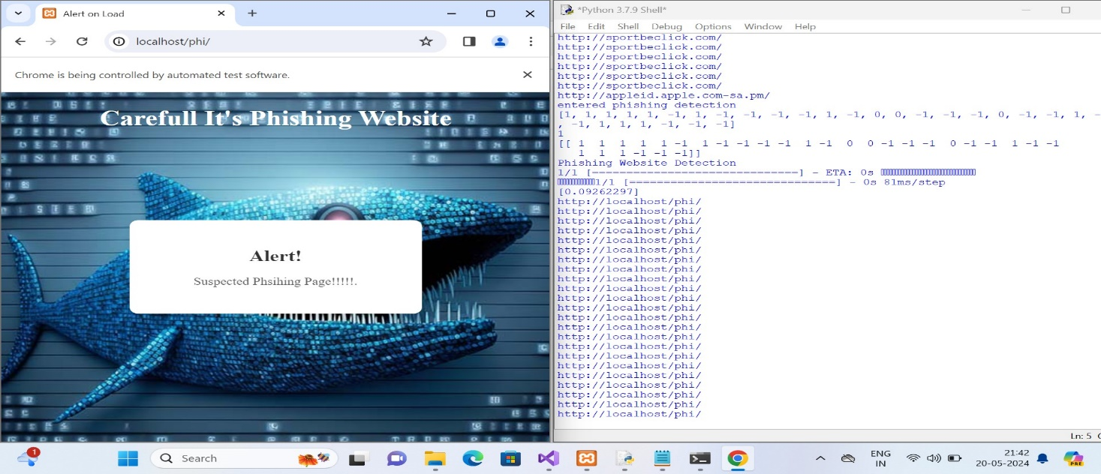
Fig.8 Popup Message which is showing alert after entering Phished website

Slide 29

Fig.7 Phished Website

Slide 30
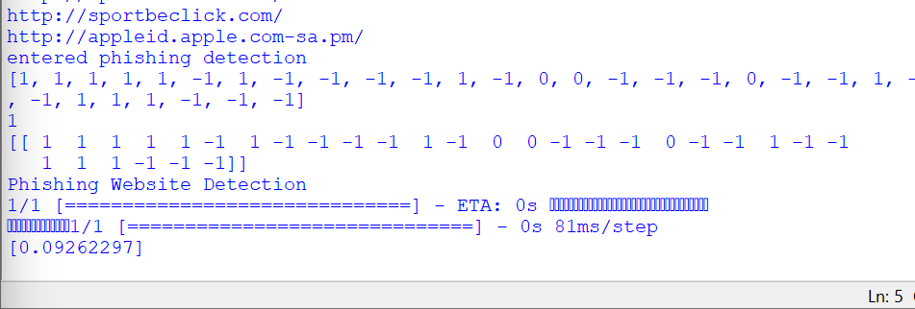
Fig.9 Feature Analysis

Slide 31
CONCLUSION
Anti-phishing measures are critical in safeguarding users and organizations against malicious attempts to steal sensitive information. Deep learning model like LSTM is used for developing advanced anti-phishing systems capable of detecting and preventing sophisticated phishing attempts. Through Selenium automation, this solution operates seamlessly in real-time, continuously monitoring visited URLs and promptly flagging phishing threats during browsing sessions. By staying vigilant, adopting best practices, and continuously innovating anti-phishing measures, individuals and organizations can reduce the likelihood of falling victim to phishing attacks and protect their digital assets and privacy.

Slide 32
PUBLICATION
Akshatha A P, Chaithra R, Madhura S, Chandana C Sagar, Hiriyanna G S, “Literature Review on Phishing Website Detection Using Deep Learning”, International Journal of Scientific Research in Engineering and Management (IJSREM), Volume: 08 Issue: 05 | May - 2024.
Akshatha A P, Chaithra R, Madhura S, Chandana C Sagar, Hiriyanna G S, “Anti-Phishing: A Web Identifier For Spoofed Sites Using Neural Network”, International Journal of Scientific Research in Engineering and Management (IJSREM), Volume: 08 Issue: 05 | May – 2024 | DOI: 10.55041/IJSREM34558.

Slide 33
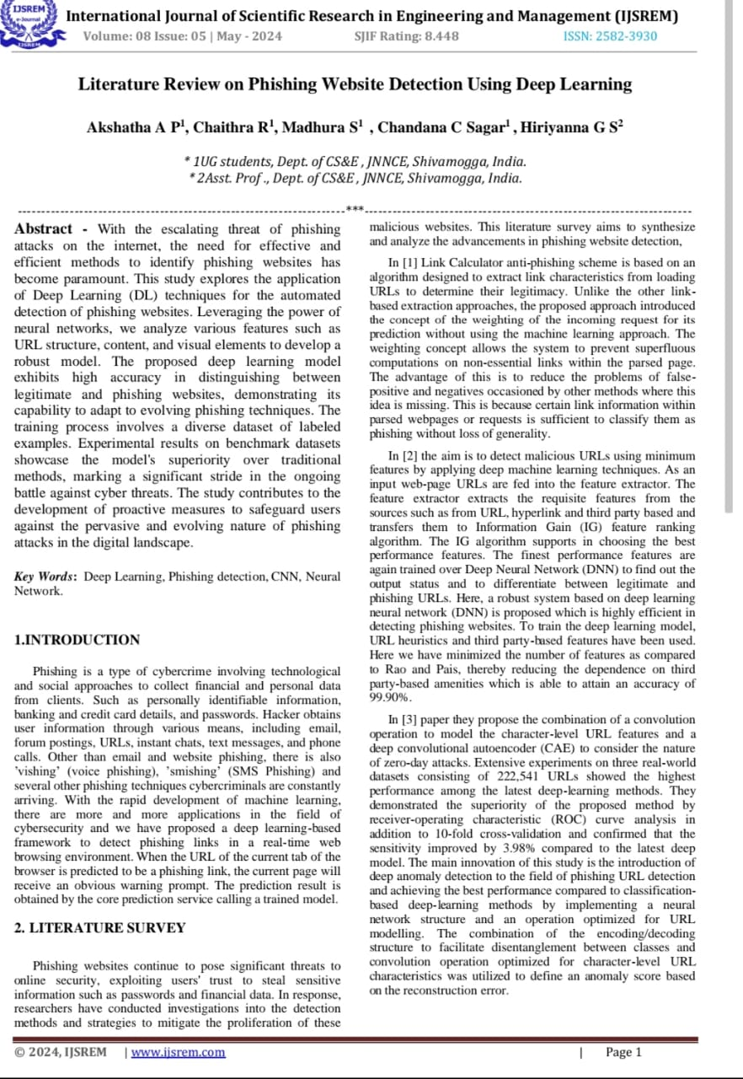

Slide 34
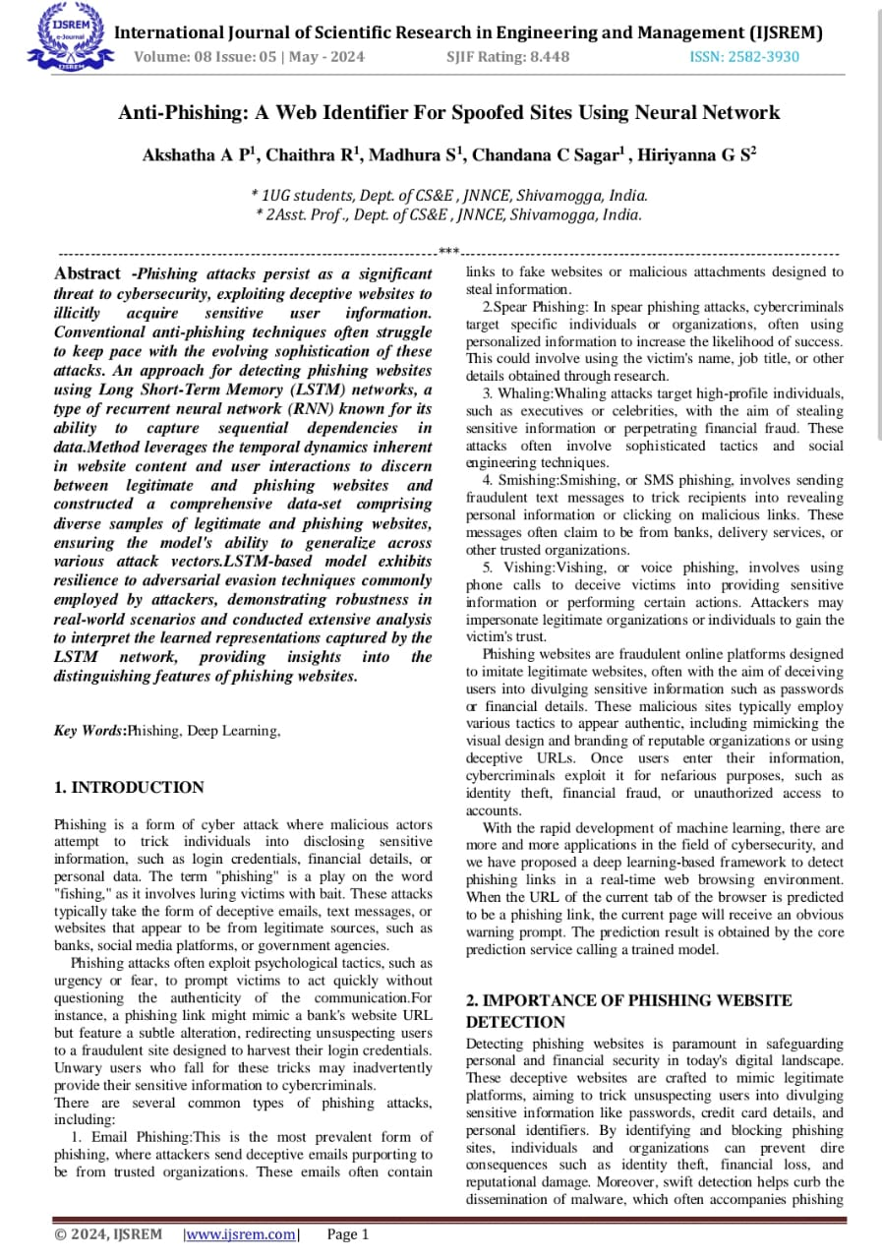

Slide 35
REFERENCES
[1] Orunsolu Abioduna, Sodiya A.Sb, Kareem S.O, Link Calculator –an efficient link- based phishing detection tool, Acta Informatica Malaysia, Volume 4, Issue 2, September 2020, p. 37-44 [RESEARCH GATE].
[2] Khan, Md Faisal; Rana, B L, Detection of Phishing Websites Using Deep Learning Technique, Turkish Journal, Volume 12, Issue 10, April 2021, p.3880-3892 [PROQUEST].
[3] Seok-junbu, Sung-bae cho, Deep Character-Level Anomaly Detection Based on a Convolutional Autoencoder for Zero-Day Phishing URL Detection, Electronics (Korea), Volume10, Issue 12, June 2021 [MDPI].
[4]Lizhen Tang, Qusay H. Mahmoud, A Deep Learning-Based Framework for Phishing Website Detection, IEEE, Volume 10, December 2021, p. 1509 – 1521. [IEEE].
[5]Rundong Yang, KangfengZheng, Bin Wu, Chunhua Wu and Xiujuan Wang, Phishing Website Detection Based on Deep Convolutional Neural Network and Random Forest Ensemble Learning, Sensors (Basel), doi: 10.3390/s21248281, December 2021[NCBI].

Slide 36
[6] Tristan Bilot, Gregoire Geis and Badis Hammi, PhishGNN: A Phishing Website Detection Framework using Graph Neural Networks, SECRYPT At Lisbo, DOI:10.5220/0011328600003283, July 2022 [RESEARCH GATE].
[7] Aman Rangapur, Tarun Kanakam and Dhanvanthini P, Phish-Defence, Phishing Detection Using Deep Recurrent Neural Networks, Cornell University, Volume 4, September 2022 [ARXIV].
[8] Chenguang Wang, Yuanyuan Chen, TCURL, Exploring hybrid transformer and convolutional neural network on phishing URL detection, Knowledge-Based Systems, Volume 258, Issue C, December 2022 [SCIENCE DIRECT].
[9] Zainab Alshingiti ,Rabeah Alaqel ,Jalal Al-Muhtadi ,Qazi Emad Ul Haq,Kashif Saleem and Muhammad Hamza Faheem, A Deep Learning-Based Phishing Detection System Using CNN, LSTM, and LSTM-CNN, Vol 23,Jan 2023 [MDPI].
[10]ShouqAlnemari, Majid Alshammari, Detecting Phishing Domains Using Machine Learning, Applied Sciences (2076-3417), Vol. 13, Issue 8, April 2023, p4649. 16p [MDPI].
[11] Eman Abdullah Aldakheel , Mohammed Zakariah , Ghada Abdalaziz Gashgari , Fahdah A. Almarshad and Abdullah I. A. Alzahrani, A Deep Learning-Based Innovative Technique for Phishing Detection in Modern Security with Uniform Resource Locators, Sensors, Vol. 23, Issue 9, April 2023 [MDPI].
[12] Manoj Kumar Prabakaran, Parvathy Meenakshi Sundaram ,Abinaya Devi Chandrasekar,An enhanced deep learning‐based phishing detectionmechanism to effectively identify malicious URLs using variational autoencoder,IET Information Security, Volume 17, Issue 3, May 2023, p. 423 – 440 [IET].

Slide 37
THANK YOU

